Slide 1

MFC4
22MAT230-Mathematics for Computing 4 Preconditioning Technique for an Image Deblurring Problem with the Total Fractional-Order Variation Model
CCB.SC.U4AIE24243 PRAVEEN REDDY
CB.SC.CU4AIE24241 POLICE.ARYAN
CCB.SC.U4AIE24230 JITHIN REDDY
CCB.SC.U4AIE24215 DEEPIKA REDDY

Slide 2
Introduction
Image deblurring is an ill-posed inverse problem
Classical methods amplify noise and blur edges
Regularization is required for stable reconstruction
Total Variation (TV)
TV preserves edges
But introduces staircase artifacts
Smooth intensity regions become piecewise constant
TFOV
Fractional derivatives are nonlocal
Provide a balance between:
Edge preservation
Smooth transitions
Reduce staircase effect significantly

Slide 3
1-D Signal Example for the Project
1. Original Signal
Consider a simple 1-dimensional signal:
u=[2,4,6,4,2]
This represents the original signal (true data).
2. Blurring Process
When the signal is captured, it becomes blurred due to a blurring operator K.
Example blur kernel:
K=1/3[1,1,1]
Applying convolution gives the blurred signal:
z=Ku
Result:
z=[2,4,4.67,4,2]
This blurred signal is the observed data.
3. Mathematical Model
The blurring model is written as
z=Ku+ϵ
Where
u→ original signal
K→ blur operator
z → observed blurred signal
ϵ → noise
Goal: recover u from z.

Slide 4
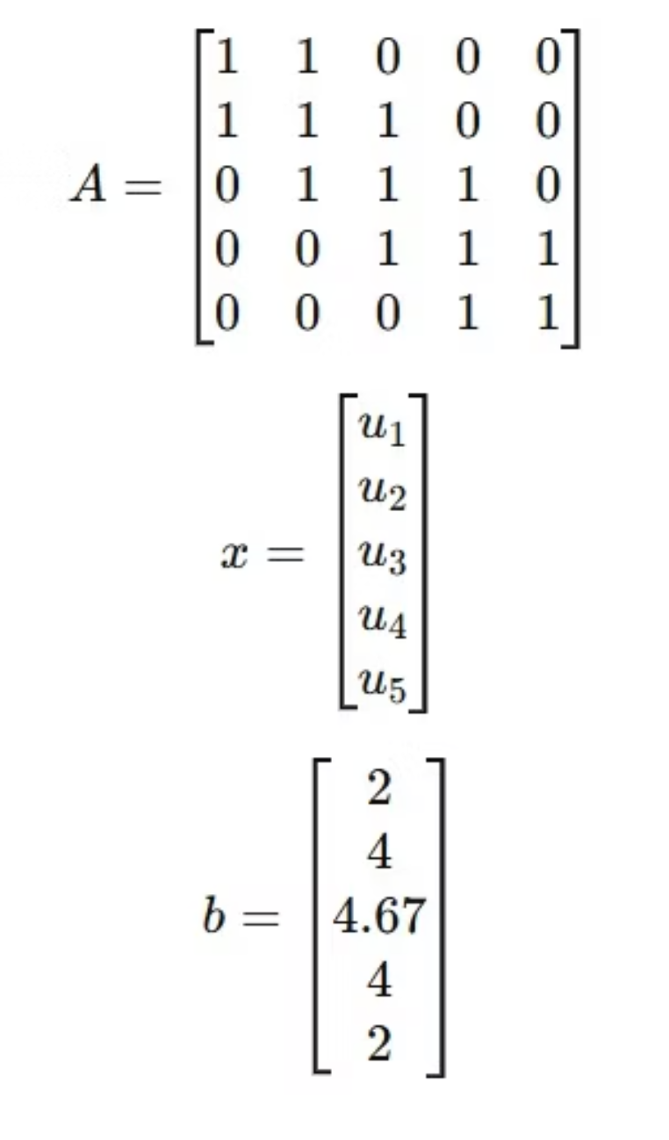
4. Discretized Linear System
After discretization, the model becomes
Ax=b
Example matrix form:

Slide 5
5. Iterative Solution
Since matrix AAA can be large and ill-conditioned, we use iterative methods:
Fixed Point Iteration (FPI) → handles nonlinear terms
PCG (Preconditioned Conjugate Gradient) → inner iterations
FGMRES → outer iterative solver
These methods gradually update xxx until the reconstructed signal is close to the original signal.
Recovered signal (approximate)
u≈[2,4,6,4,2]

Slide 6
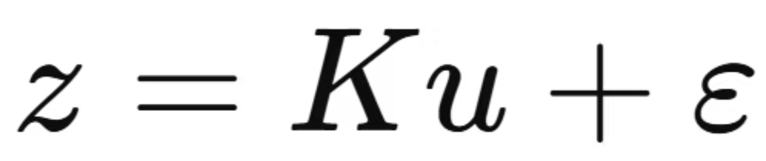
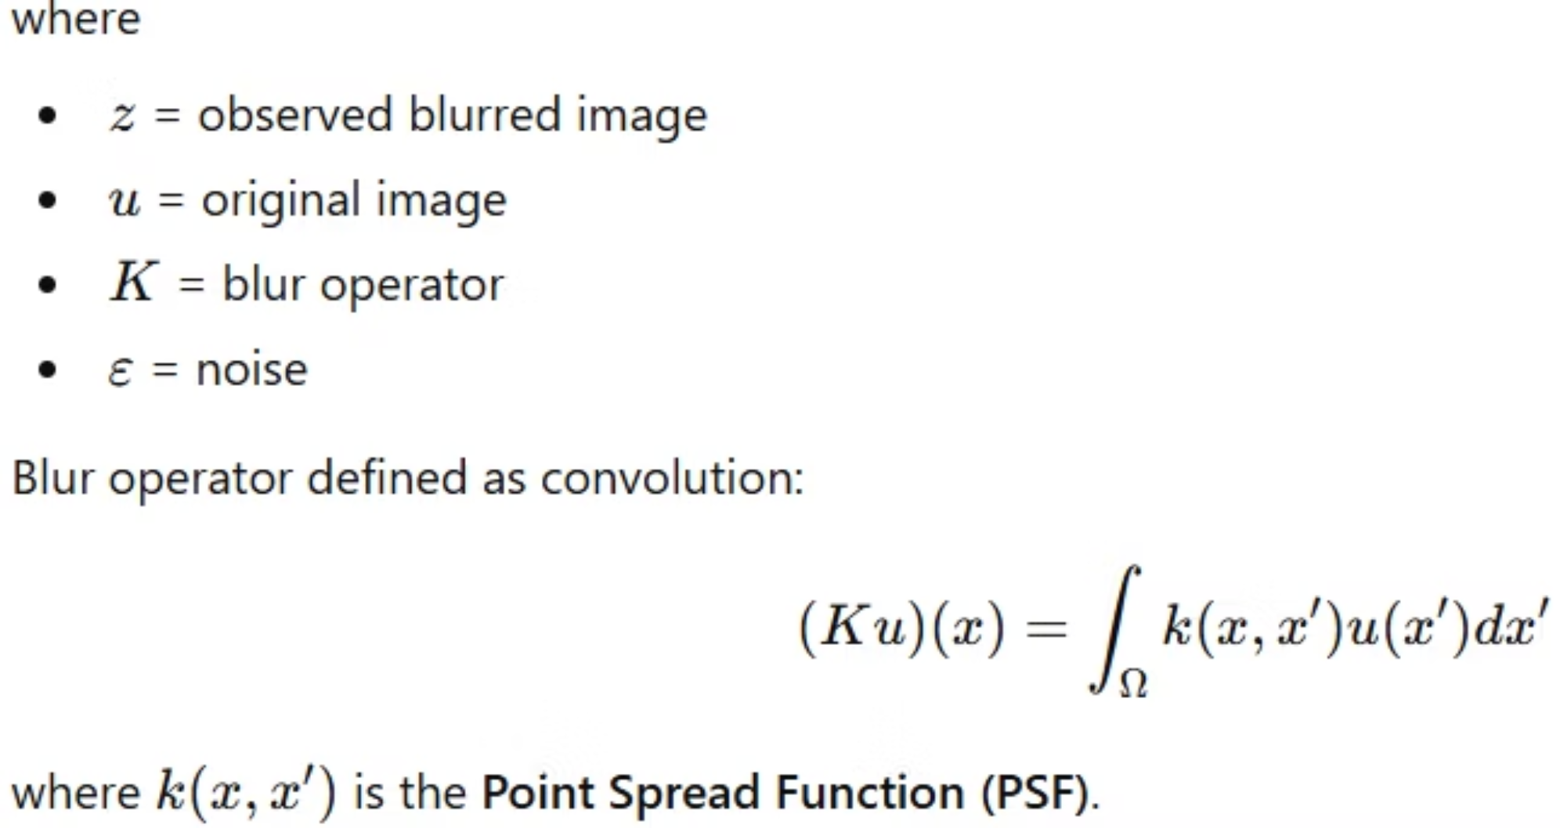
Image Deblurring Problem Formulation
Forward model

Slide 7
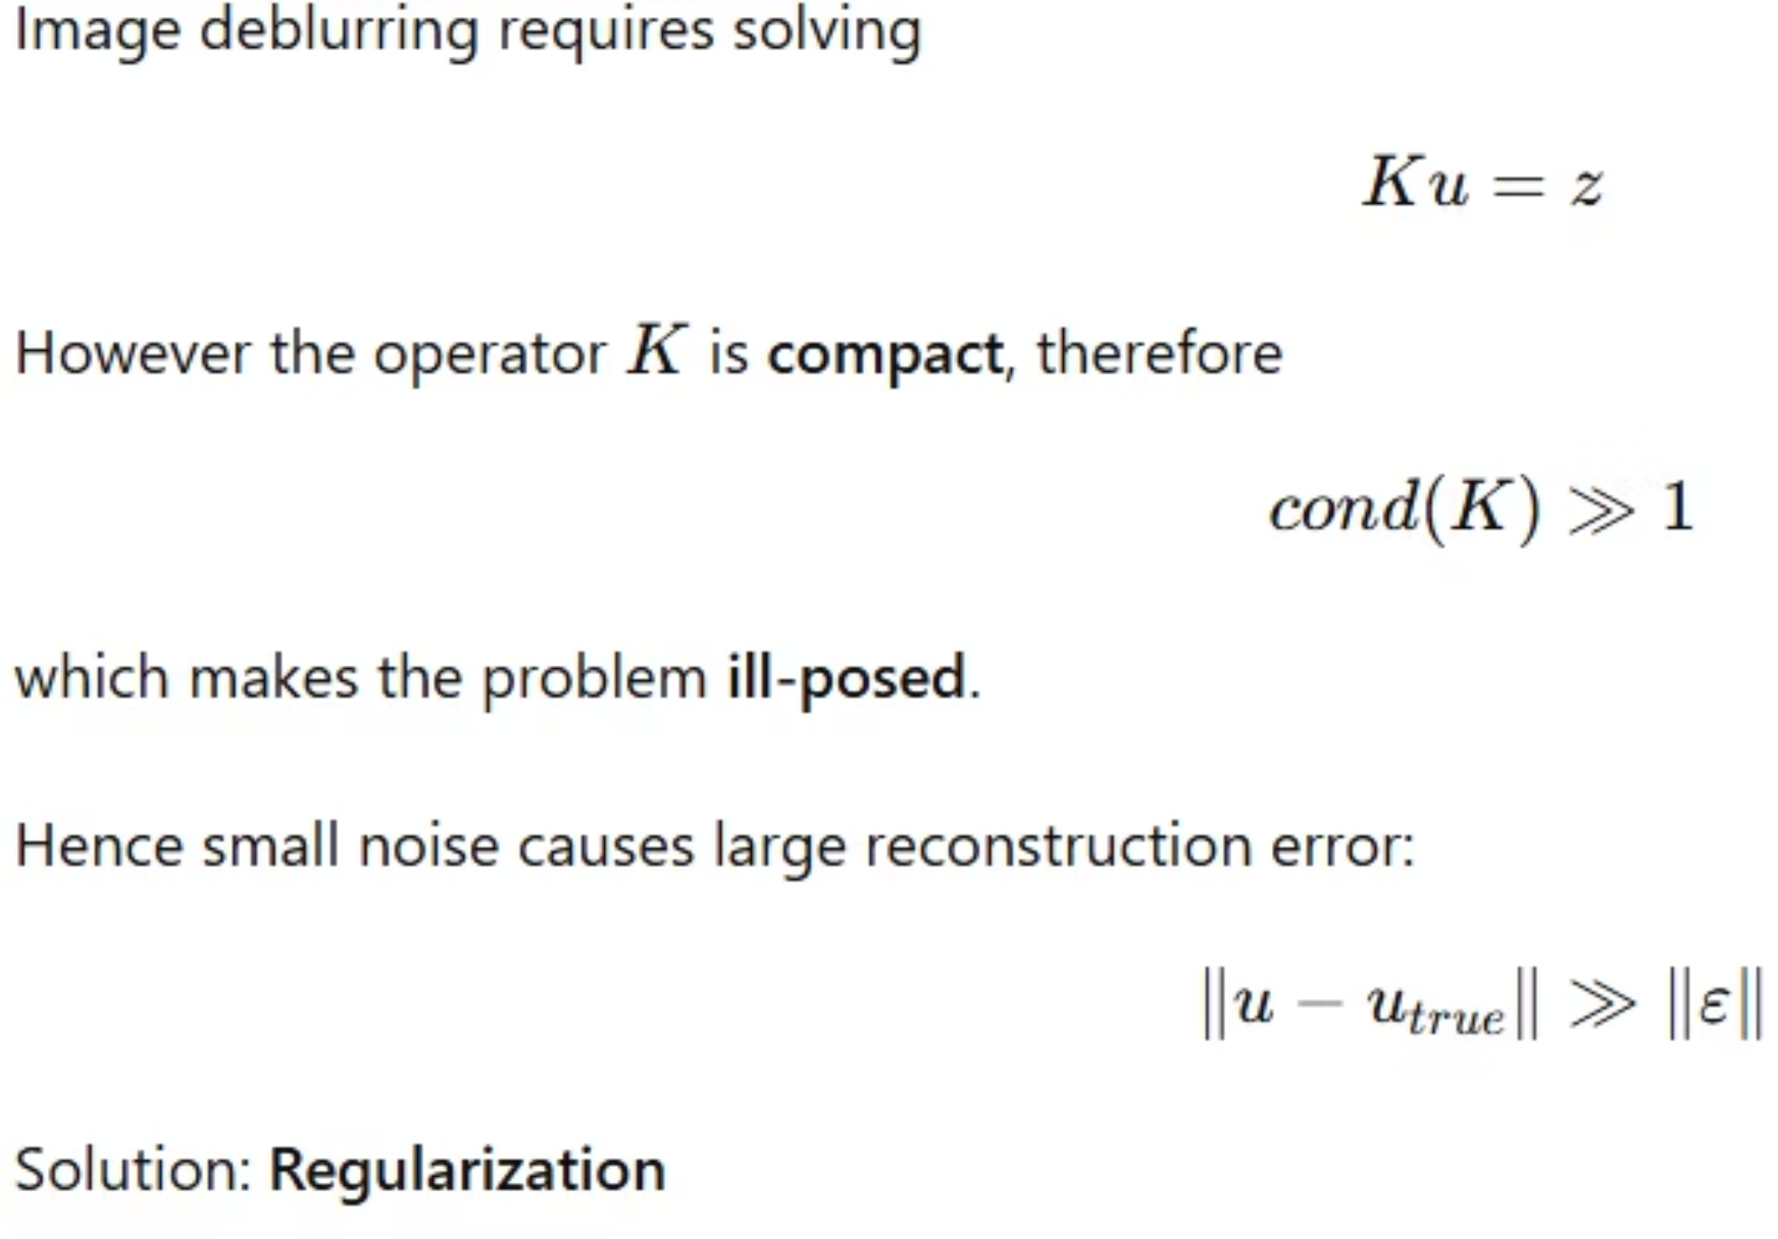
Ill-posed Inverse Problem

Slide 8
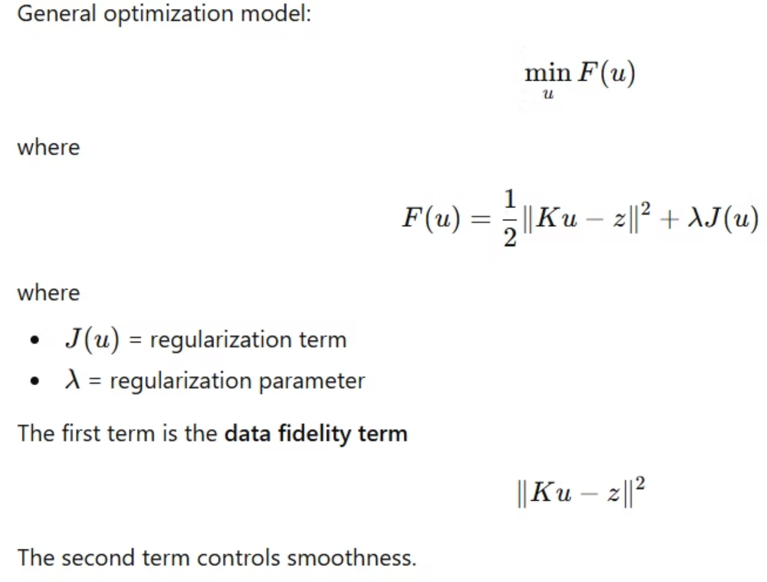
Regularization Framework

Slide 9
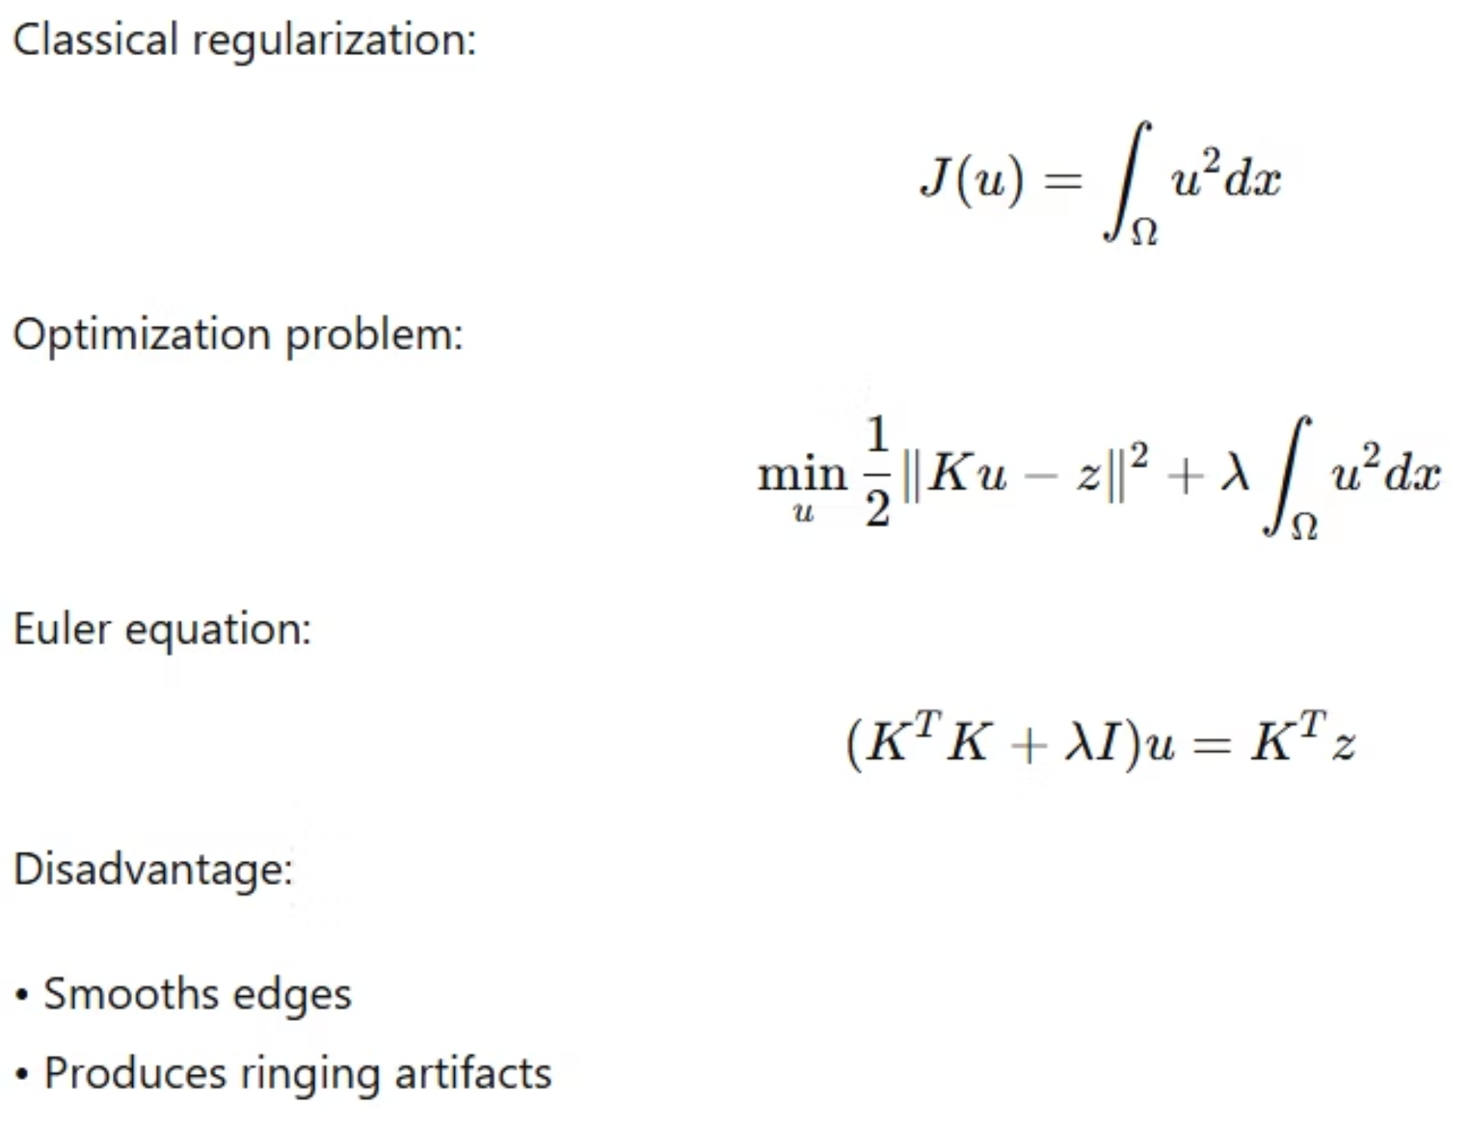
Tikhonov Regularization

Slide 10
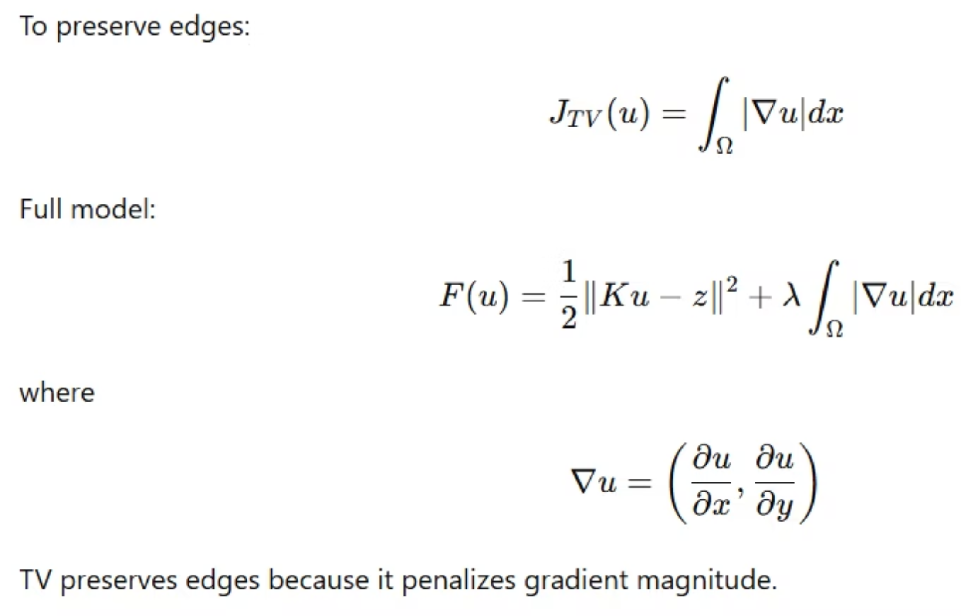
Total Variation (TV) Model

Slide 11
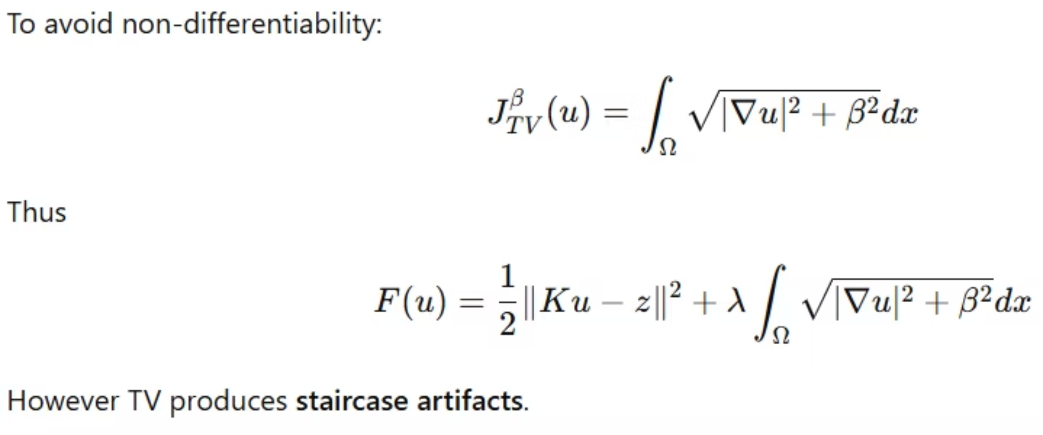
Modified TV Model

Slide 12
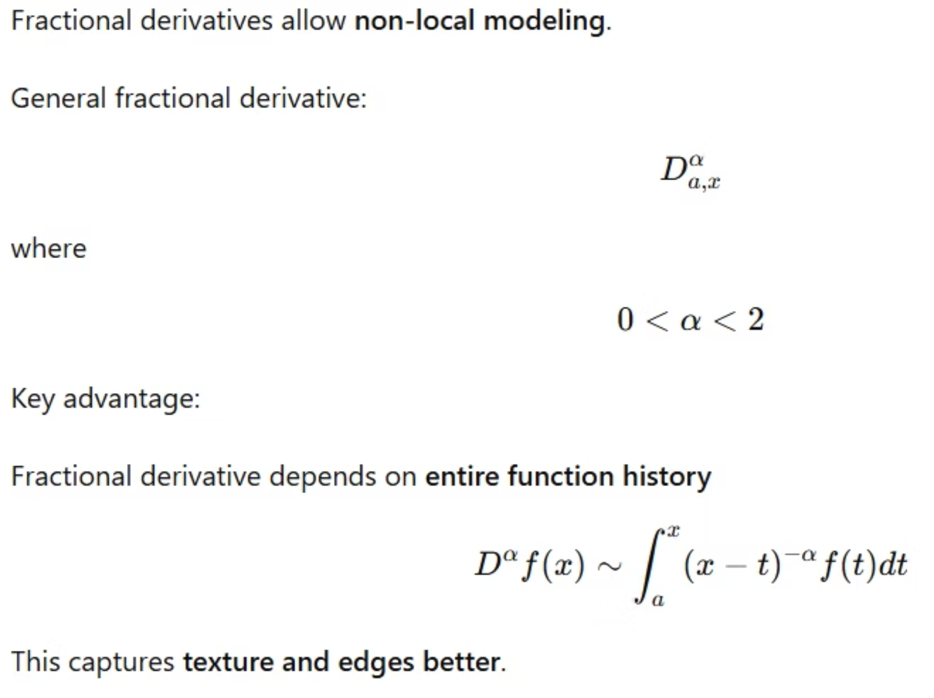
Fractional Calculus

Slide 13
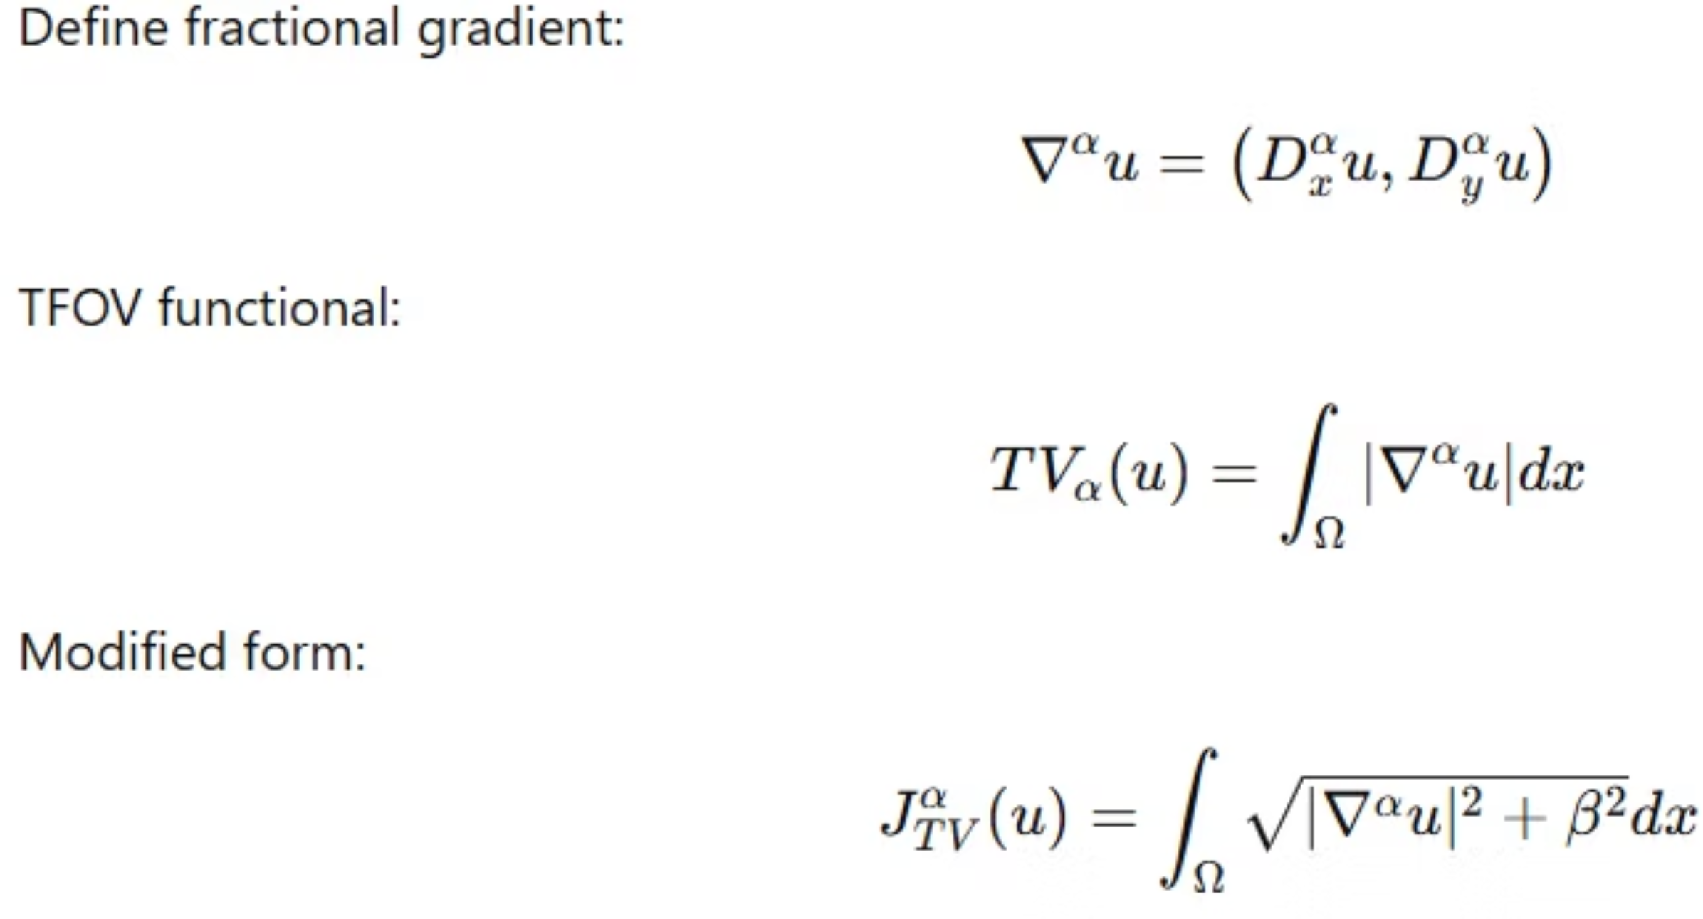
Fractional-Order Total Variation (TFOV)

Slide 14
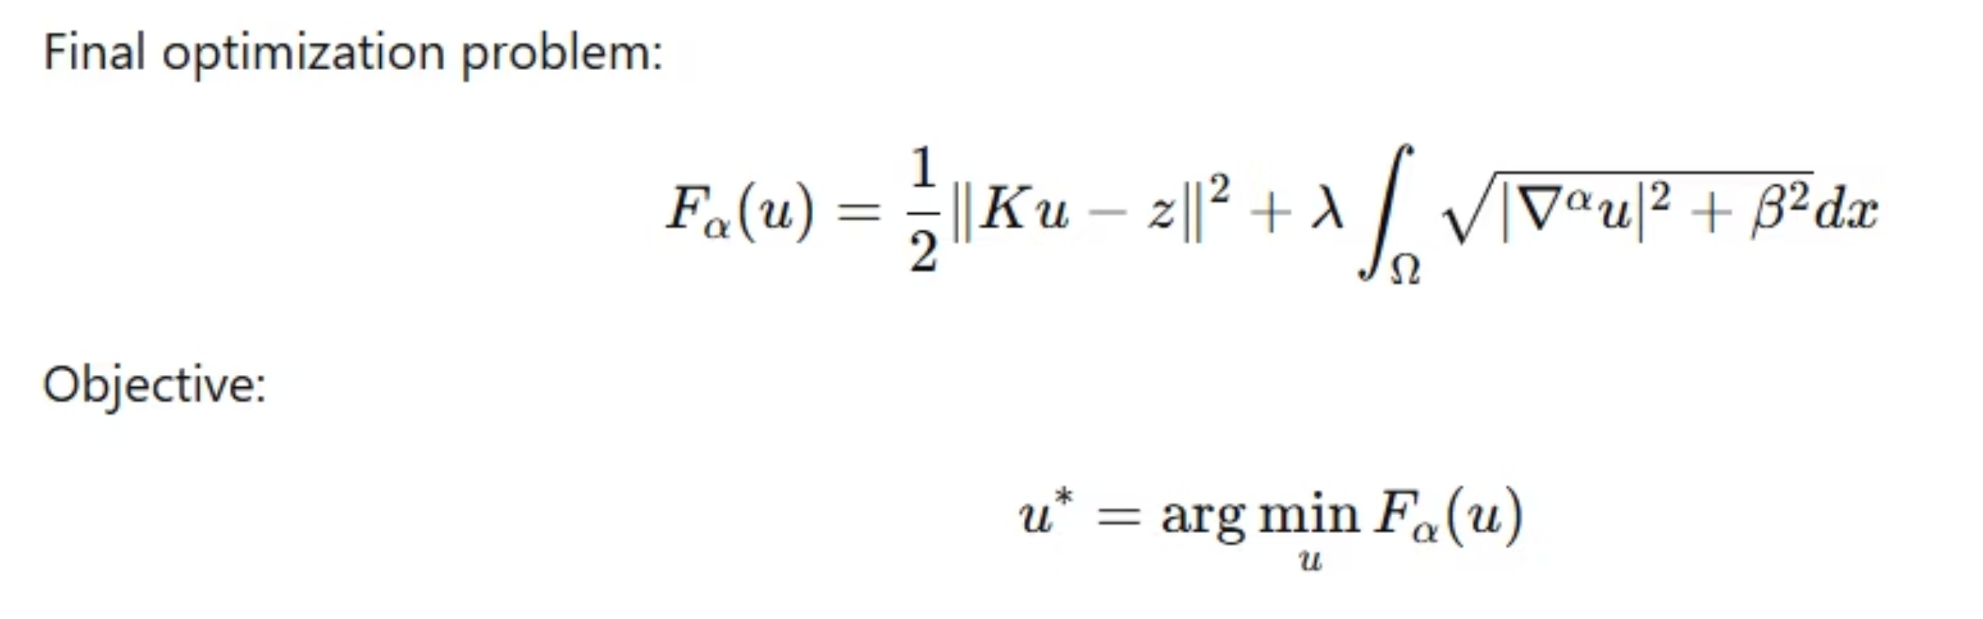
TFOV Optimization Model

Slide 15
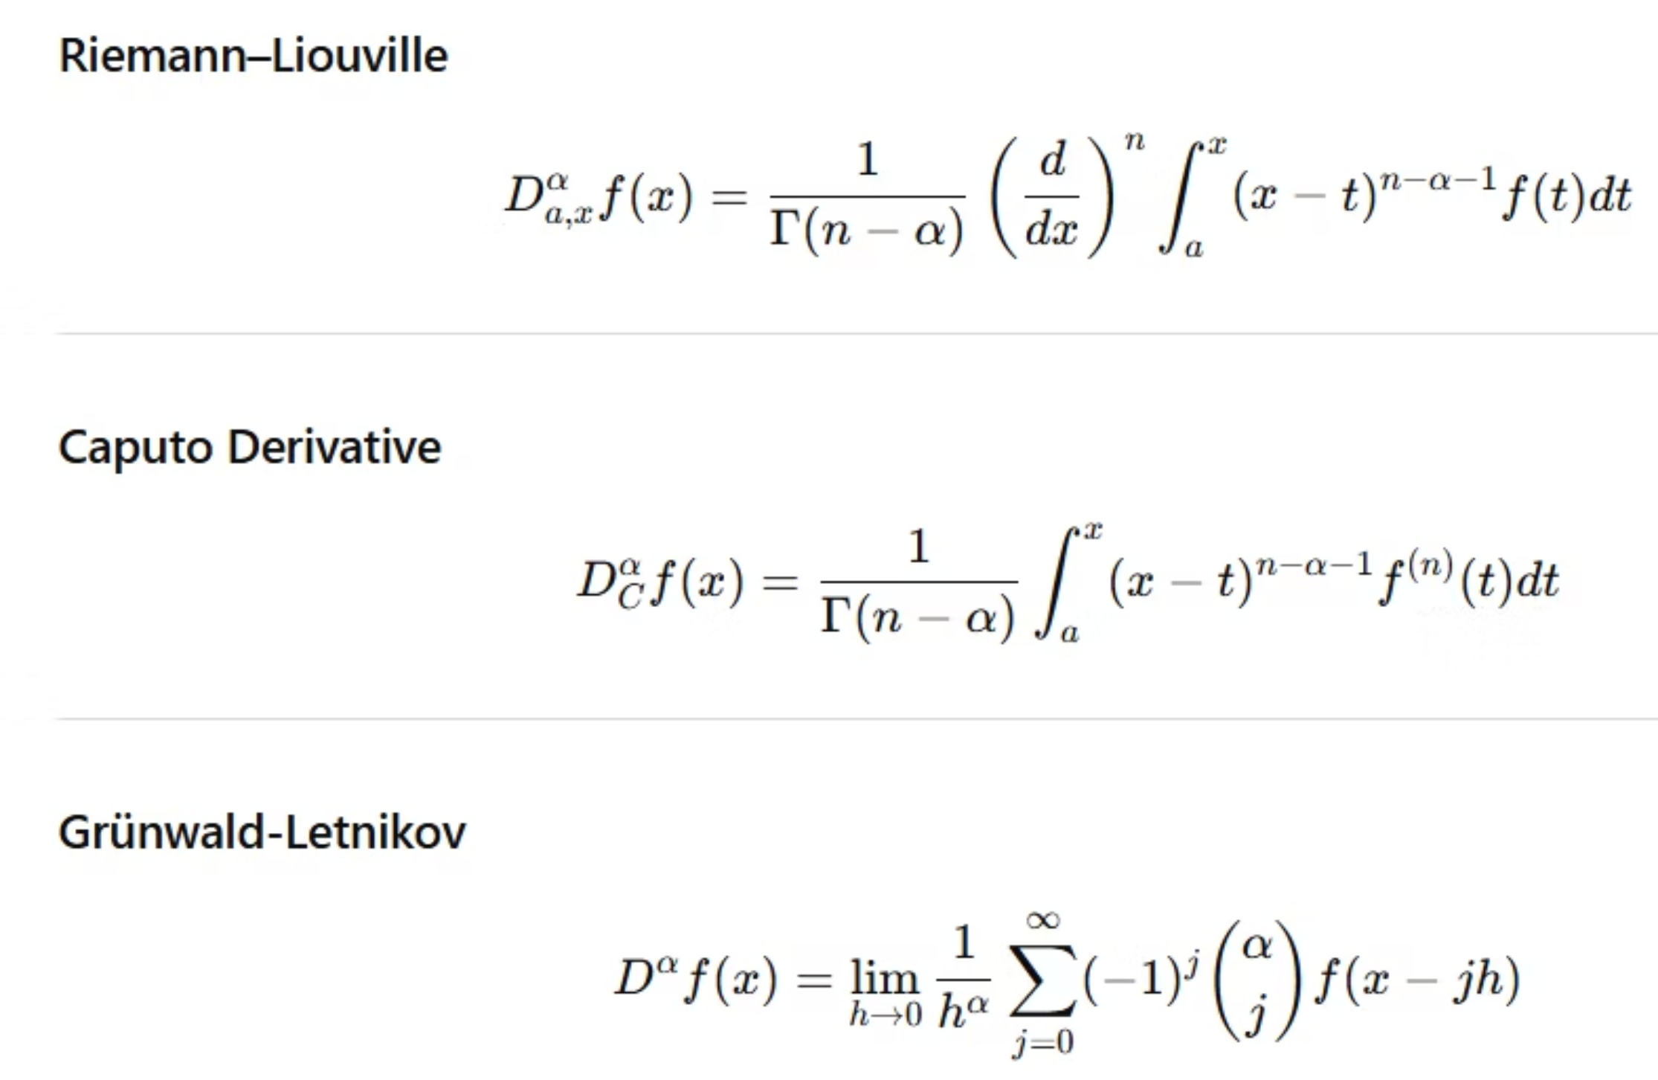
Fractional Derivative Definitions

Slide 16
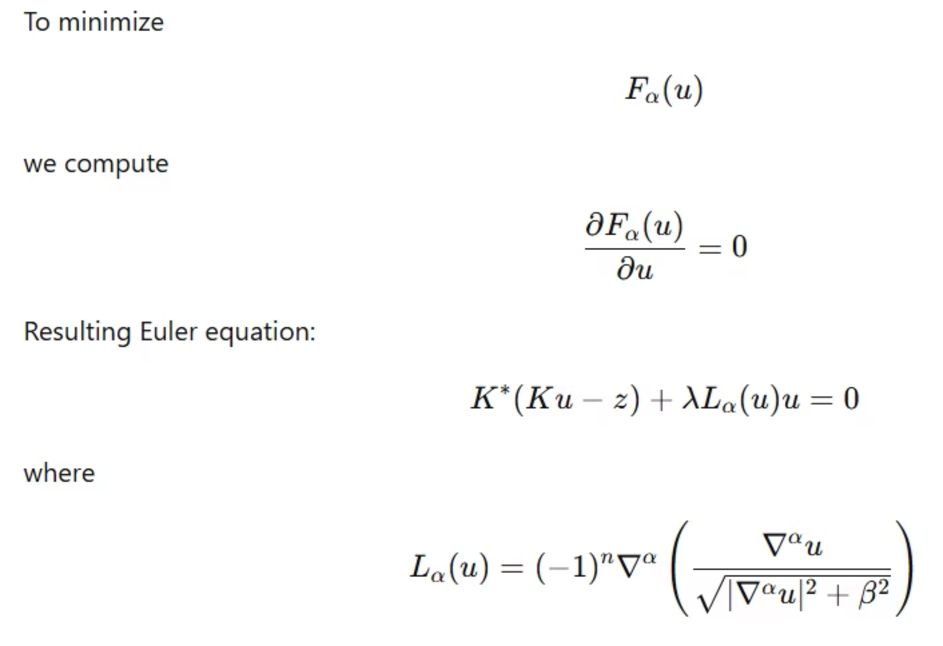
Euler-Lagrange Equation

Slide 17
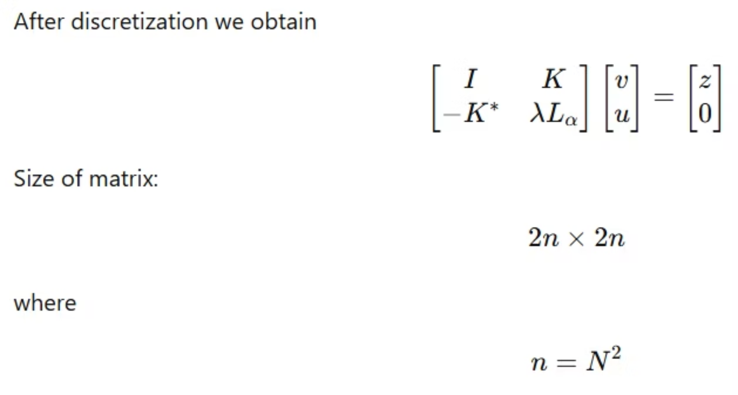
Nonlinear System

Slide 18
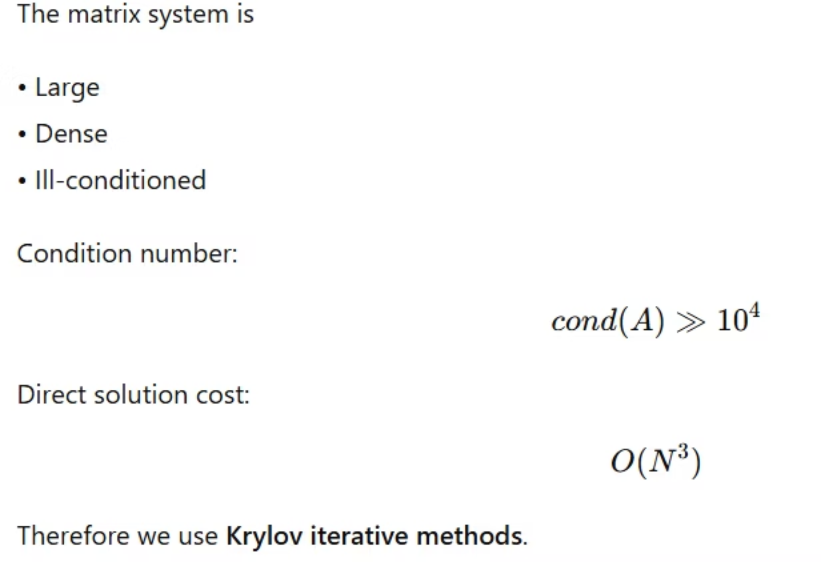
Computational Challenges

Slide 19
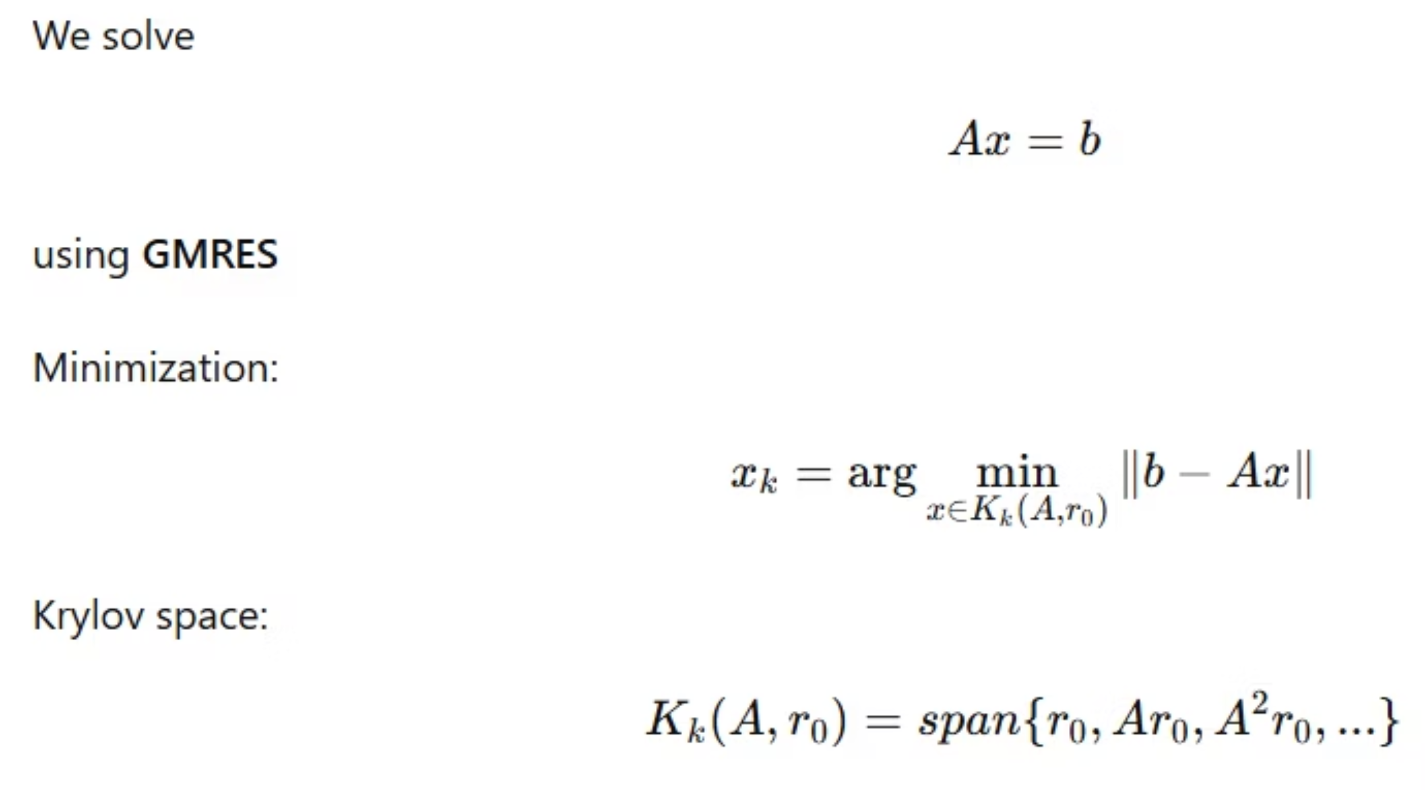
GMRES Method

Slide 20
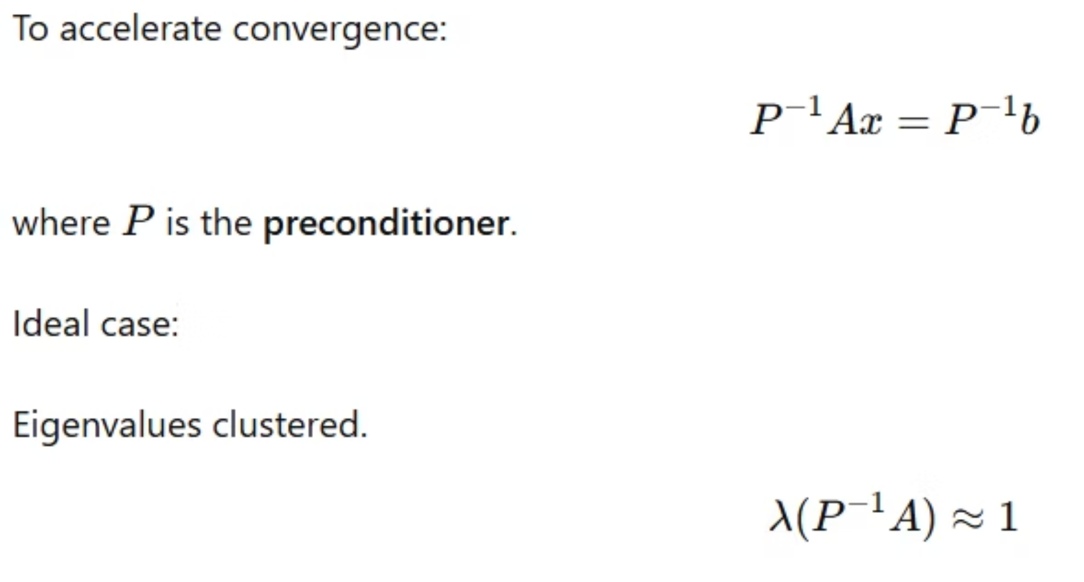
Preconditioning

Slide 21
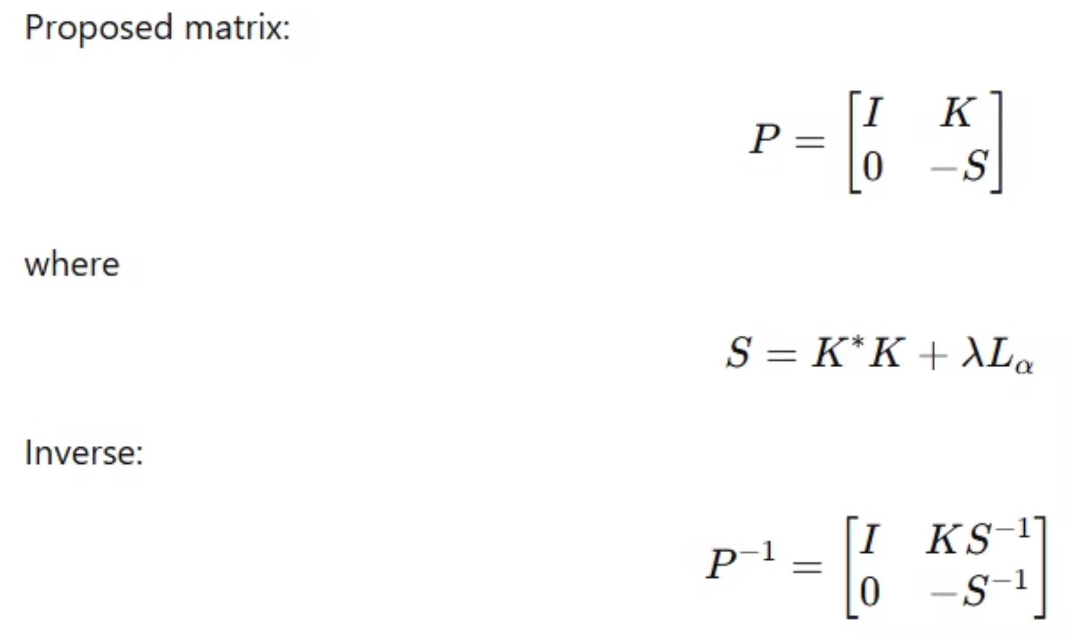
Block Triangular Preconditioner

Slide 22
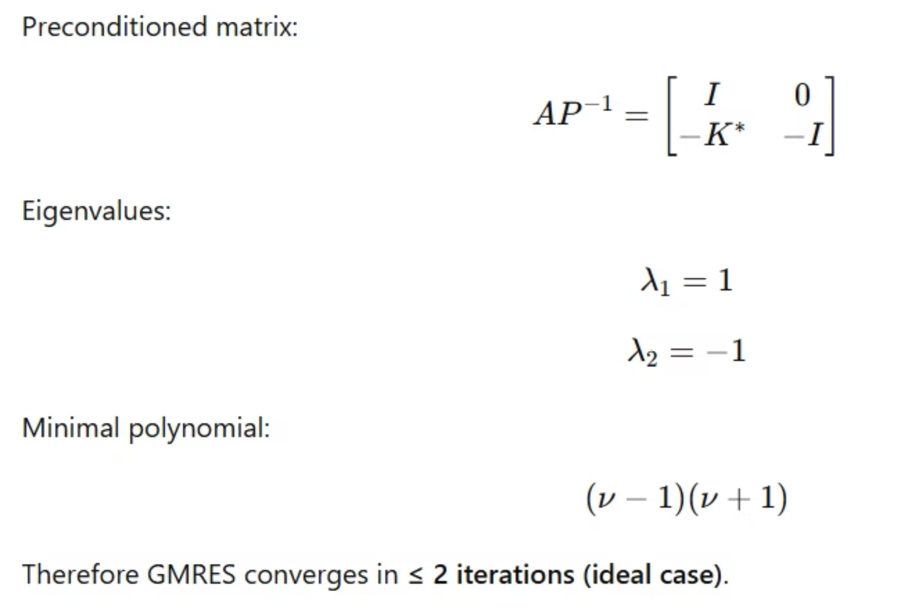
Eigenvalue Analysis

Slide 23
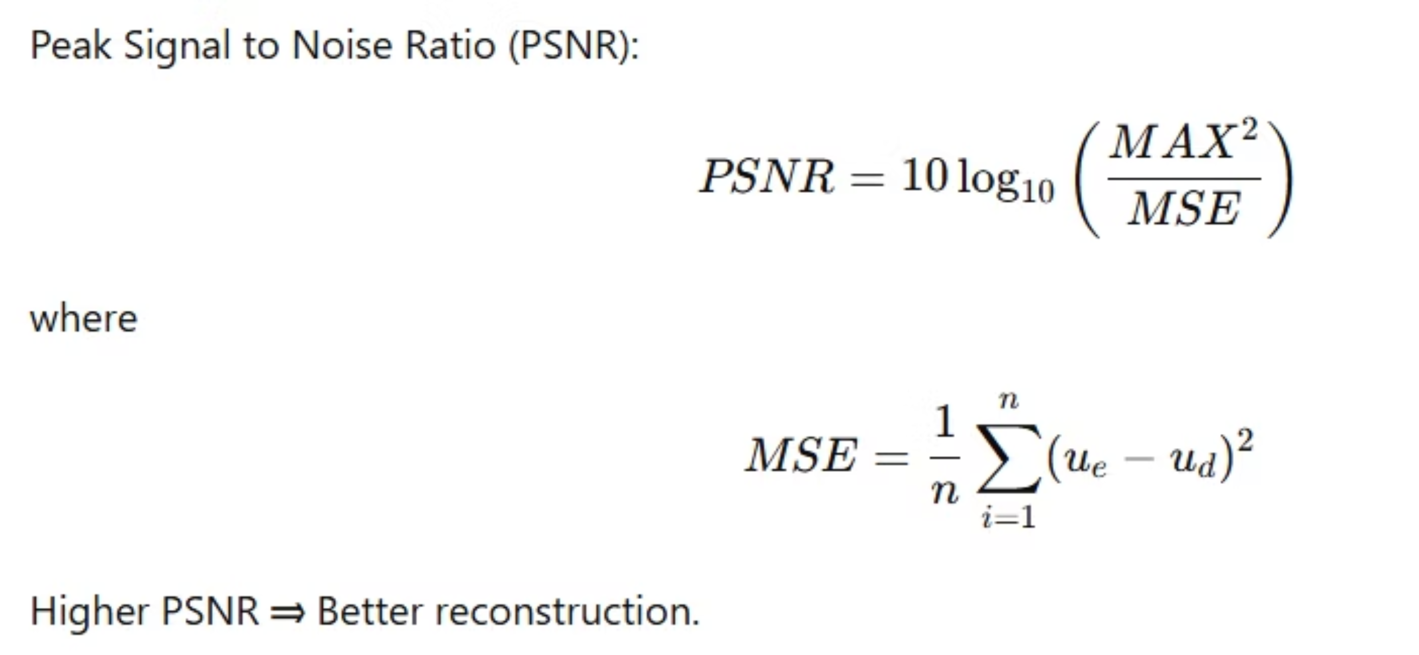
Image Quality Metric

Slide 24
Algorithm Overview
The computational steps are:
Start with an initial guess of the image.
Apply Fixed Point Iteration to linearize the nonlinear model.
Use FGMRES algorithm to solve the linear system.
Apply preconditioners P1 and P2 to accelerate convergence.
Repeat iterations until error tolerance is satisfied.

Slide 25
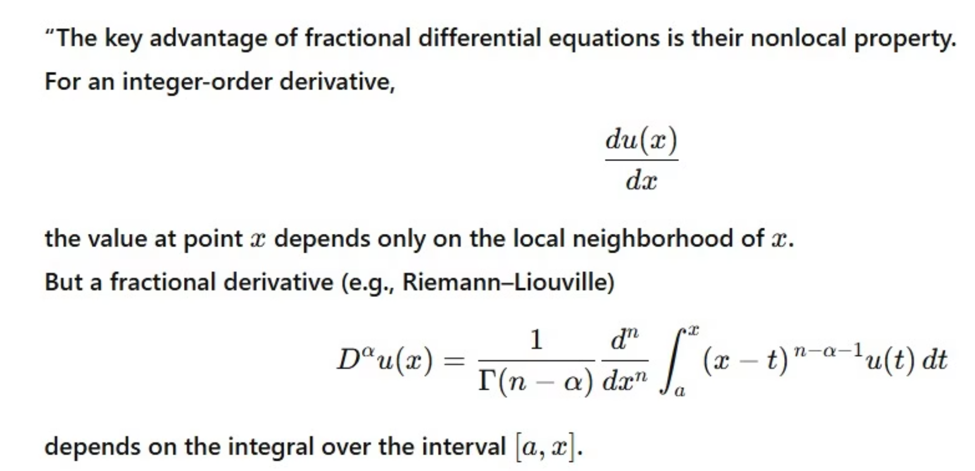
the most important advantage of using fractional differential equations in their nonlocal property

Slide 26
Difference between noise and blur
Feature
Blur
Noise
Definition
Blur is the loss of sharpness in an image.
Noise is random unwanted variations in pixel values.
Appearance
Image looks smooth and unclear.
Image looks grainy or speckled.
Effect on Image
Edges and details become soft or smeared.
Random dots or color spots appear in the image.
Main Causes
Out-of-focus lens, camera shake, motion of objects.
Low light, high ISO, sensor errors, electronic interference.
Example
A photo taken without proper focus.
A photo taken in low light with high ISO.

Slide 27
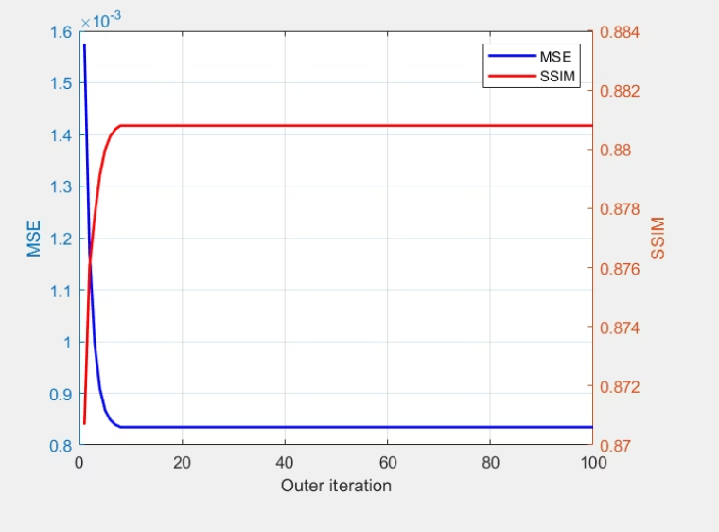
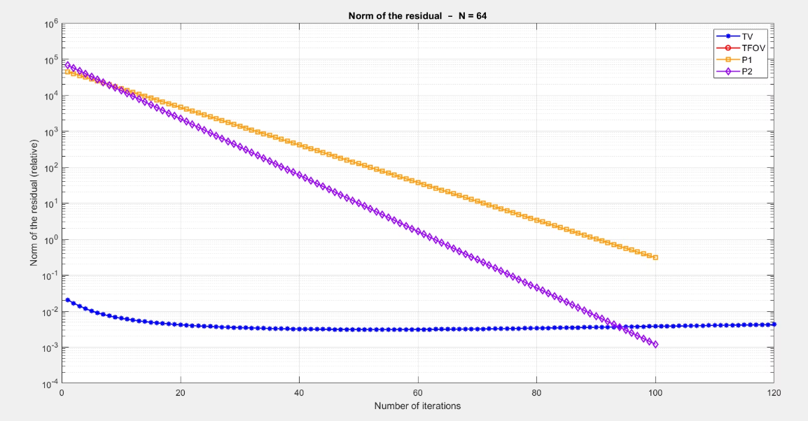
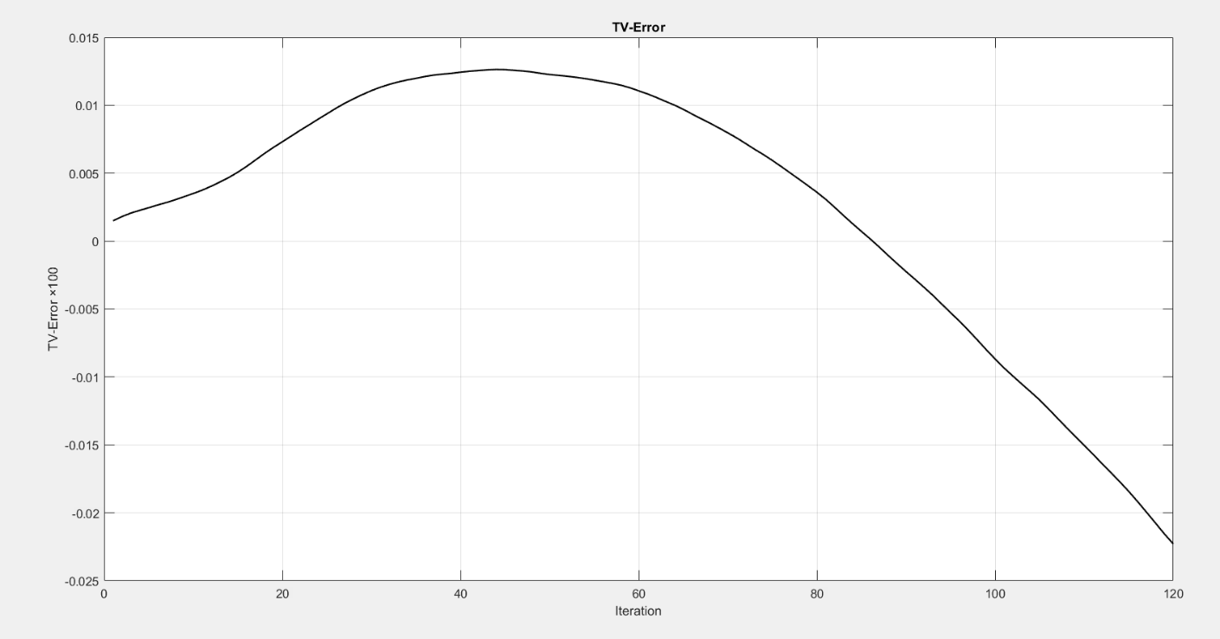
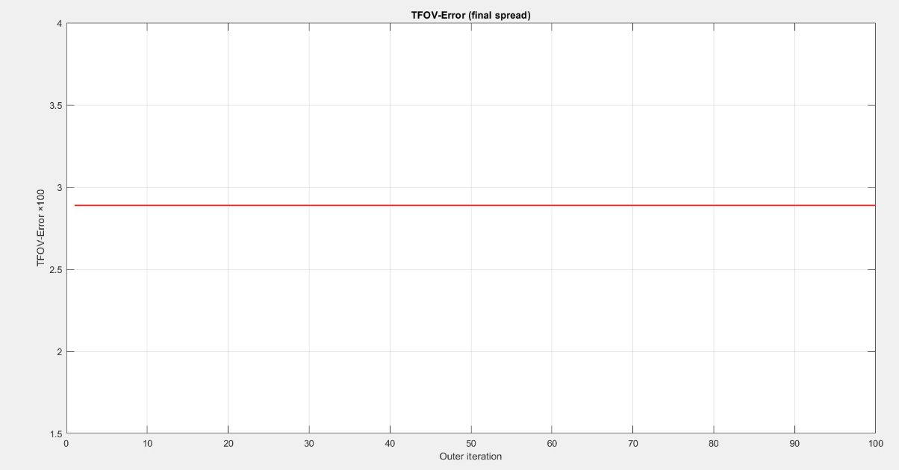
Results(goldenhouse-alpha=0.9)

Slide 28
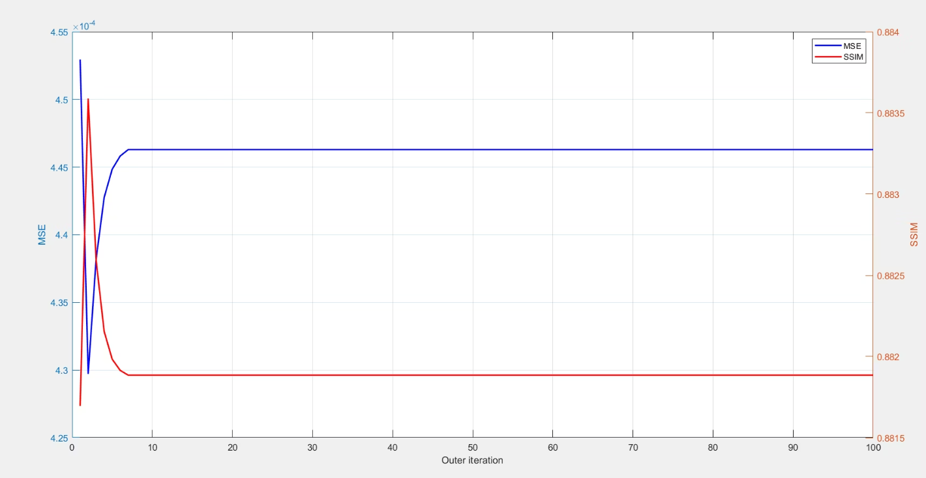
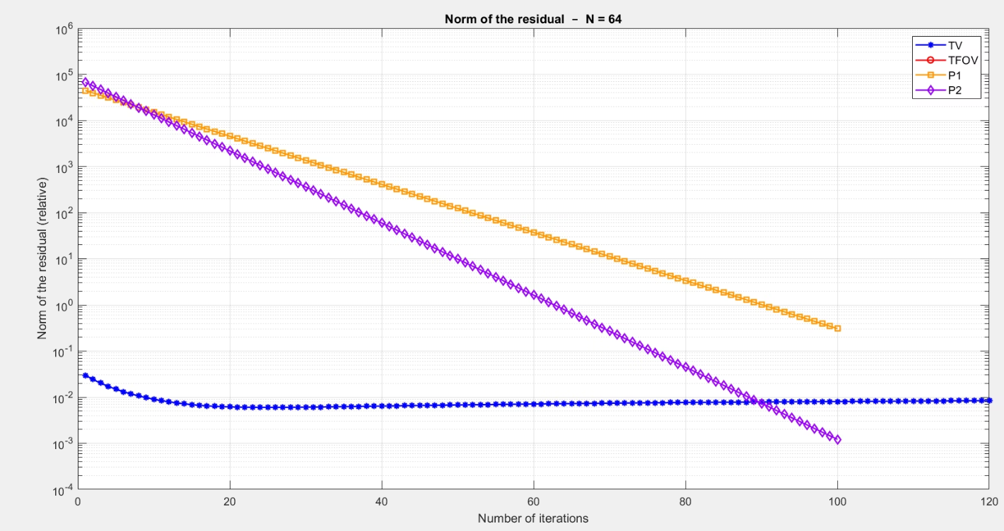
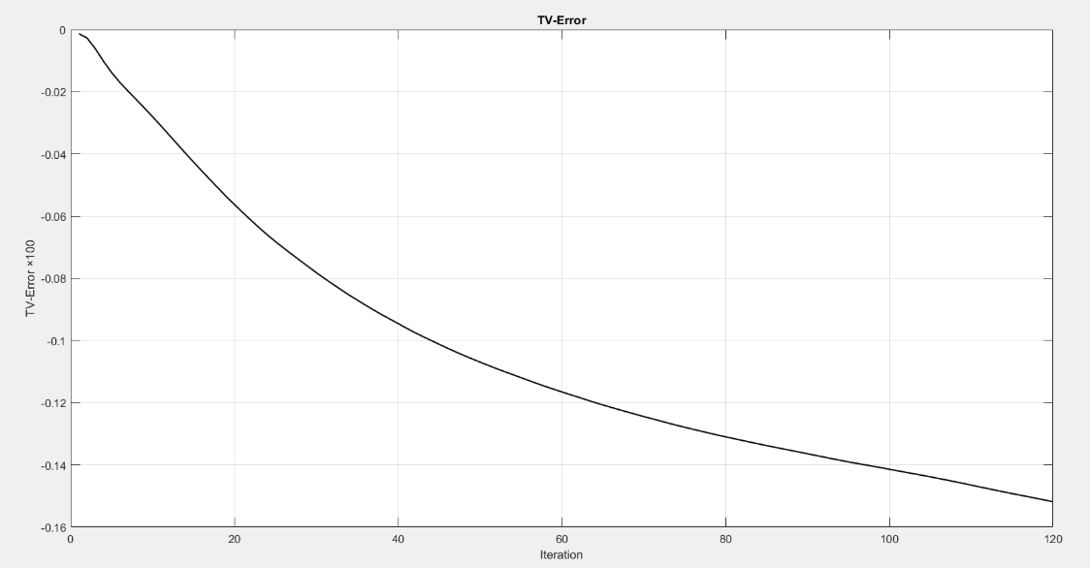
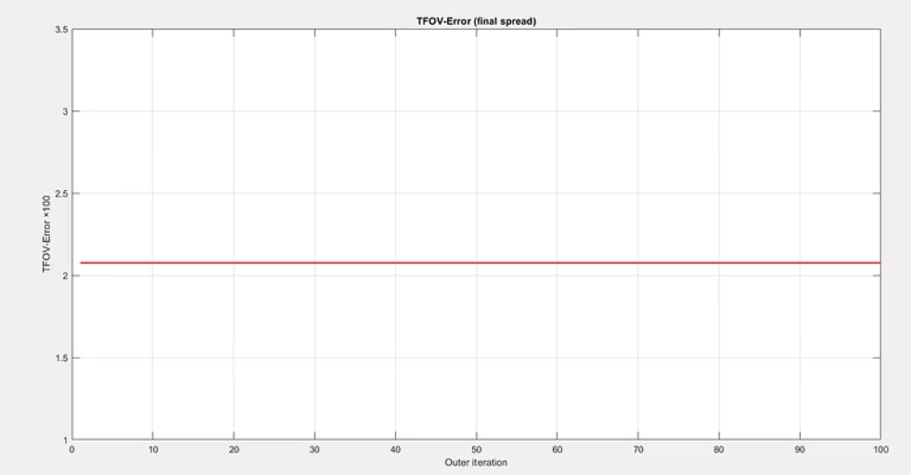
Results(eyeretina-alpha=1.3)

Slide 29
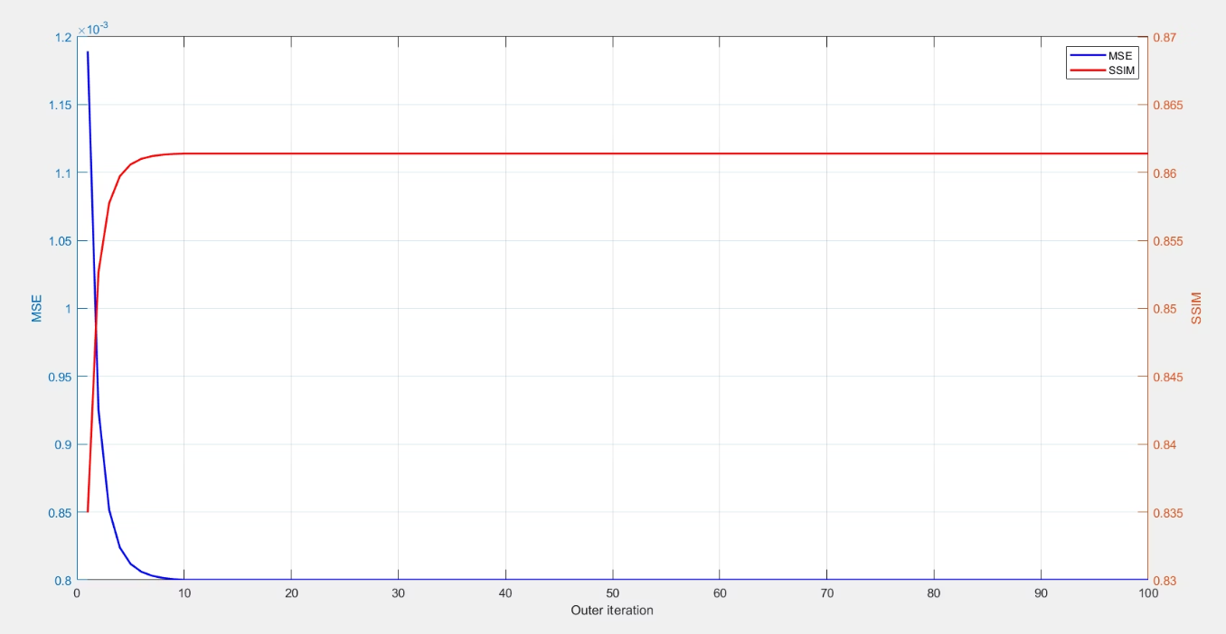
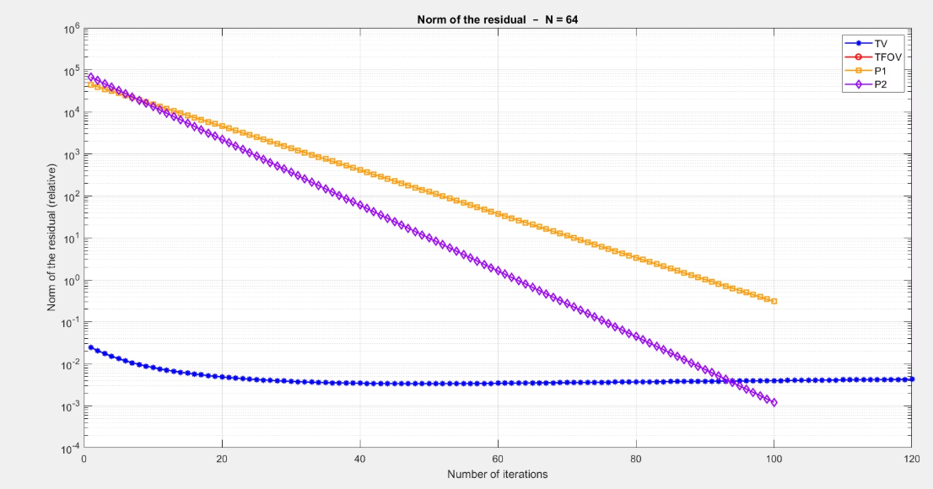
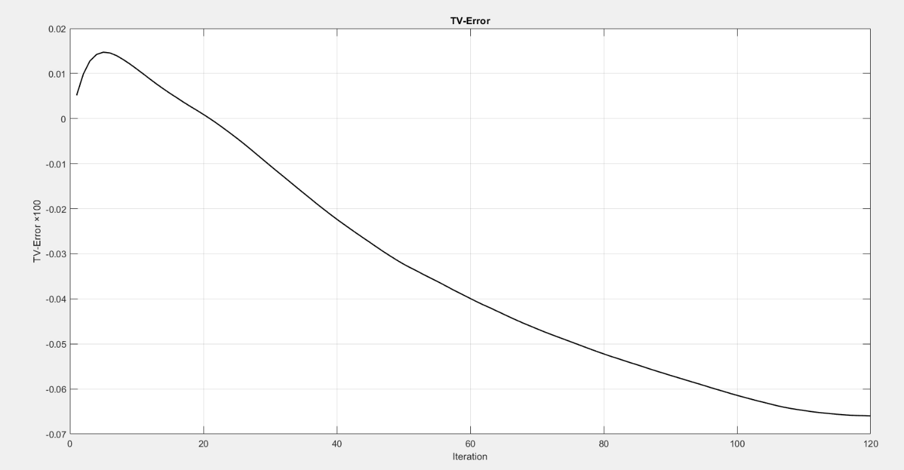
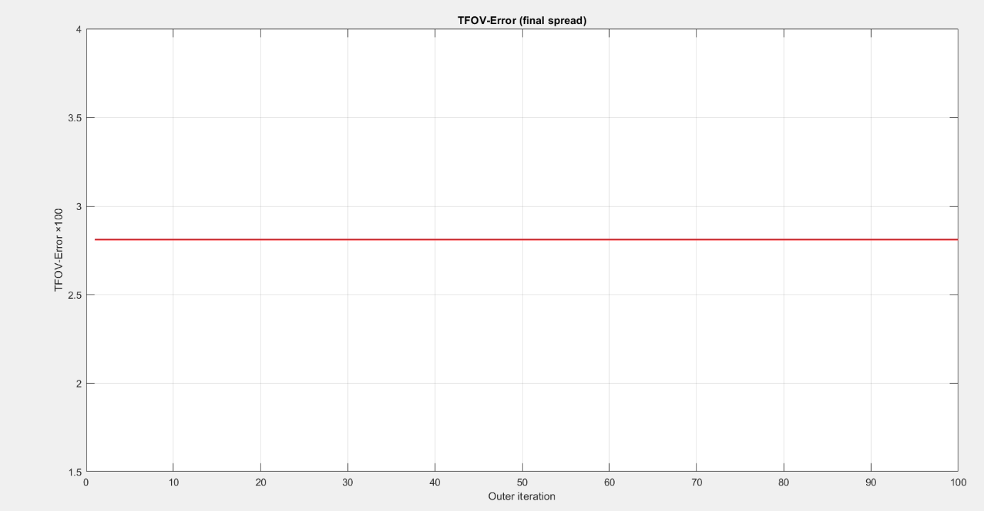
Results(cameraman-alpha=2.1)

Slide 30
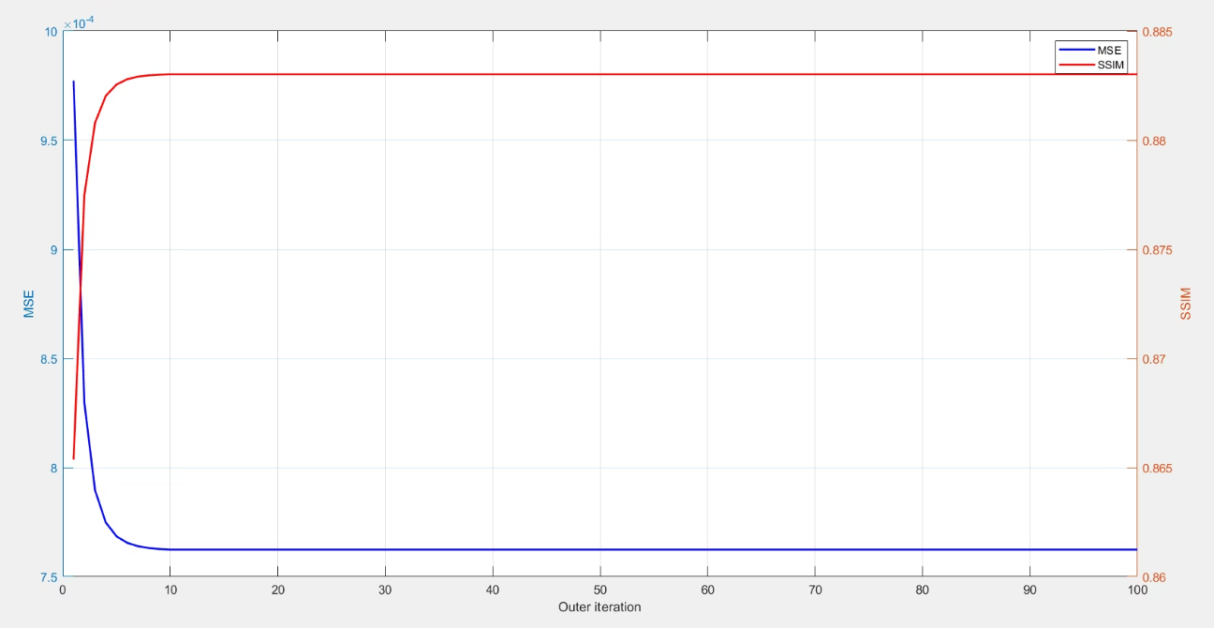
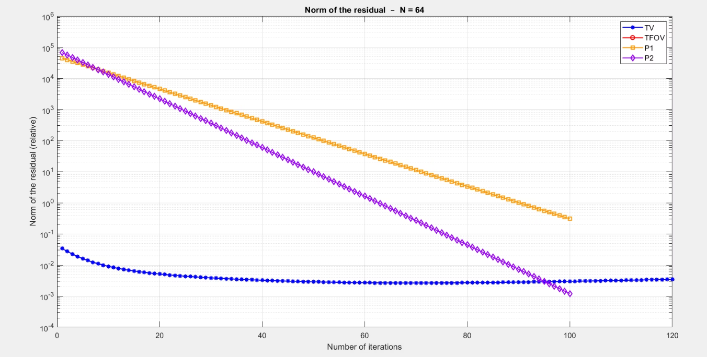
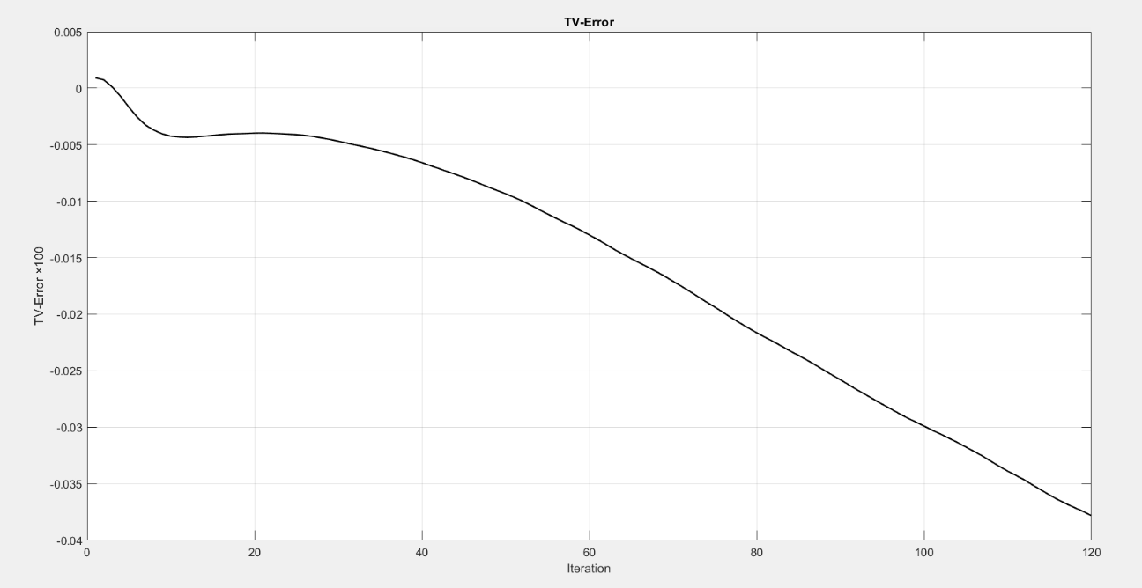
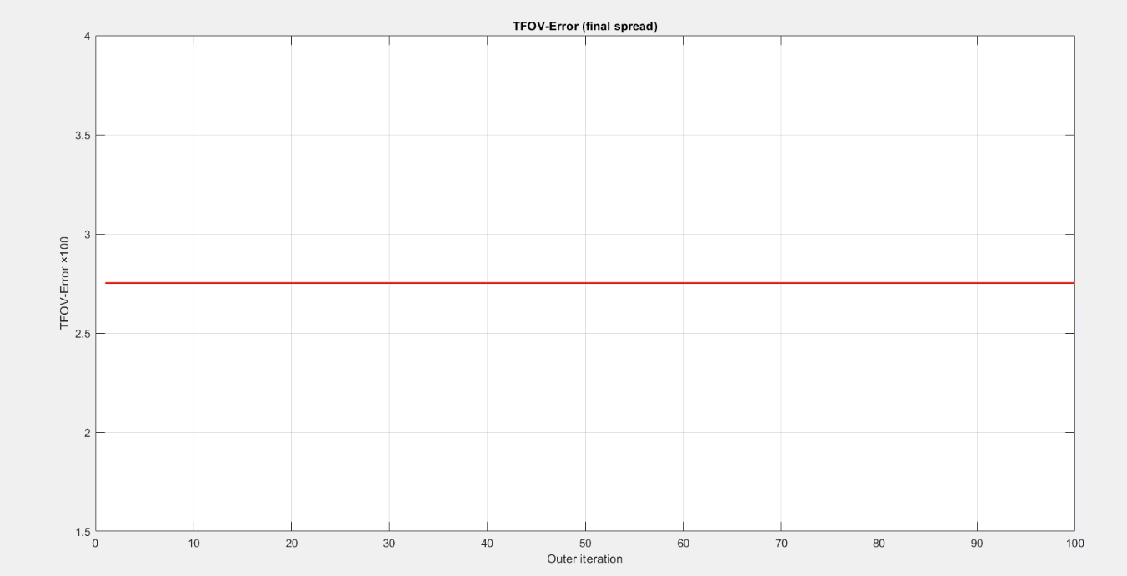
Results(peppers-alpha=2.9)

Slide 31
Thank you

